Slide 1

Hybrid
Movie
Recommendation
System
CS 541-A
Artificial Intelligence
Master of Science in Computer Science
Stevens Institute of Technology
Group No. 9
Thanapoom Phatthanaphan
Chandini Rayadurgam
Shreya Daniel Jacob

Slide 2






INTRODUCTION
Objective
User’s behavior
Collaborative Filtering
Develop a Hybrid Movie Recommendation System that overcomes traditional system limits by combining CF and CBF techniques.
Problem
Cold Start - Lack of data for new users
Data Sparsity - Limited data available for some movies
Hybrid System
Content-Based Filtering
Movie’s features
CF: Collaborative Filtering
CBF: Content-Based Filtering
Problem
Limited Diversity – Limited to only recommending movies with similar features
Source of Dataset:
https://grouplens.org/datasets/movielens/1m/
The dataset contains 1 million ratings from 6000 users on 4000 movies
Presentation Flow
Techniques
Implementation
Evaluation
Conclusion
Stevens Institute of Technology

Slide 3




TECHNIQUES
IMPLEMENTATION
EVALUATION
CONCLUSION
Common techniques for recommendation system
Collaborative Filtering
Content-Based Filtering
How it works
Recommend movies to a particular user based on similar users like
Recommend movies to a particular user based on similar movies that a particular user like
Figure
User C liked
User A and B liked
Similar movies
Similar users
User A
User B
User C
User A liked
Recommend to user B
Recommend to user C
Stevens Institute of Technology

Slide 4
TECHNIQUES
IMPLEMENTATION
EVALUATION
CONCLUSION
Advantages vs Disadvantages between CF and CBF
Collaborative Filtering
Content-Based Filtering
Advantages
Not require movie features
Can recommend unexpected movies (such as an unsimilar movie to the movies that a particular user liked)
Personalized recommendations
Can recommend movies for new user that has not rated yet
This advantage is possible if the dataset includes user’s preferences but it excludes.
Thus, this research will only focus on old users.
Disadvantages
Require large amounts of user rating data for recommendation
Difficult to recommend movies for new users due to lack of rating data
Only recommend based on movie features
Require accurate movie data
Limited Diversity
Data Sparsity
Cold Start
Stevens Institute of Technology

Slide 5




TECHNIQUES
IMPLEMENTATION
EVALUATION
CONCLUSION
Hybrid system
Combination of Collaborative Filtering and Content-Based Filtering
Problems
Cold start
Data sparsity
Lack of diversity
Content-Based Filtering
(Movie’s features)
!
Added Content-Based Filtering
Collaborative
Filtering
(User’s behavior)
Movie’s features
User A liked
Similar movies
User A
Gender
Similar
users
Age
Movie A
Ratings
Movie B
Movie C
User B liked
!
Problems
Cold start
Data sparsity
Lack of diversity
User B
Recommend Movie B (top rated movie of user A) to user B
Recommend Movie C (most similar movie of Movie B) to User B
!
Added Collaborative Filtering
Hybrid system
Problems
Cold start
Data sparsity
Lack of diversity
OK
Stevens Institute of Technology

Slide 6


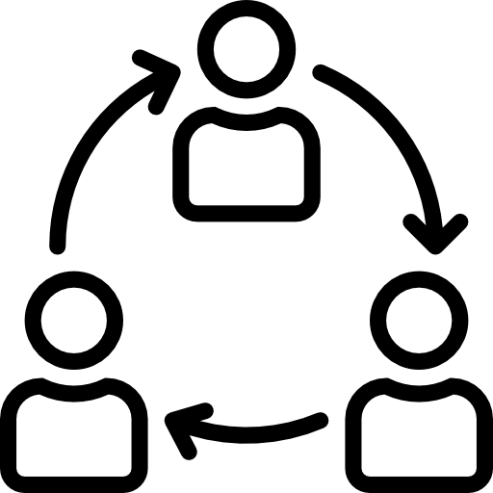



TECHNIQUES
IMPLEMENTATION
EVALUATION
CONCLUSION
Step of implementation
Implementation
Data
preprocessing
Matrix
Factorization
Build CF
(with added CBF)
Build CBF
(with added CF)
These parts are on process
(We will present our Evaluation plan)
Conclusion
Performance
comparison
Evaluation
Implement Hybrid System
Conclusion
Evaluation
Stevens Institute of Technology

Slide 7
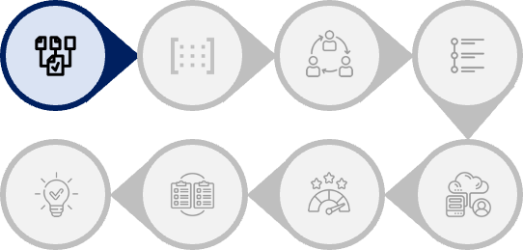
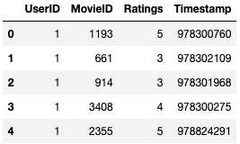
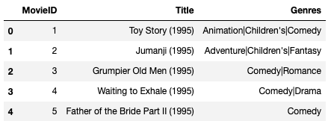
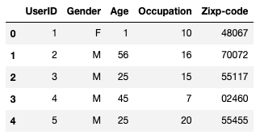
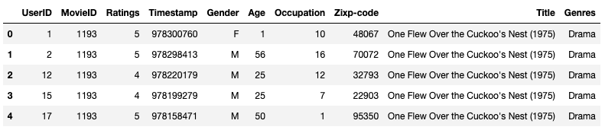
TECHNIQUES
IMPLEMENTATION
EVALUATION
CONCLUSION
Step 1 : Data Preprocessing
ratings.dat
movies.dat
users.dat
Merge 3 files into 1 file
Stevens Institute of Technology

Slide 8
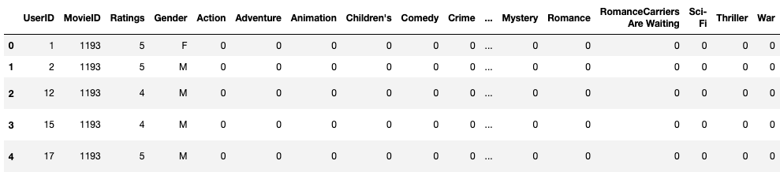
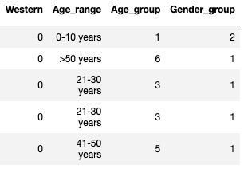
TECHNIQUES
IMPLEMENTATION
EVALUATION
CONCLUSION
Step 1 : Data Preprocessing
Restruct the matrix to contain all necessary columns
Stevens Institute of Technology

Slide 9
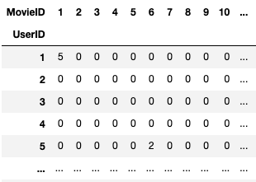
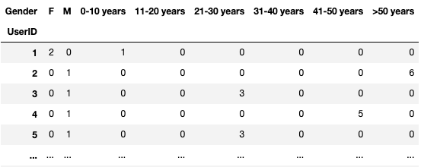

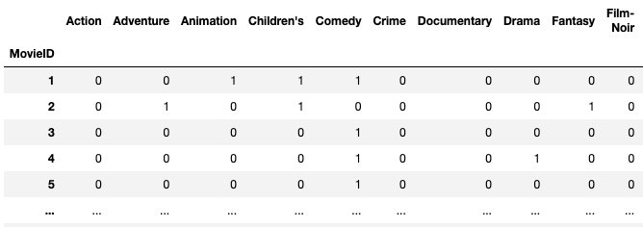
TECHNIQUES
IMPLEMENTATION
EVALUATION
CONCLUSION
Step 1 : Data Preprocessing
For Collaborative Filtering
For Content-Based Filtering
UserID – MovieID (Ratings)
(NEW) UserID – Gender&Age
For CF (with added CBF)
(NEW) MovieID – UserID (Ratings)
MovieID - Genres
For CBF (with added CF)
Stevens Institute of Technology

Slide 10
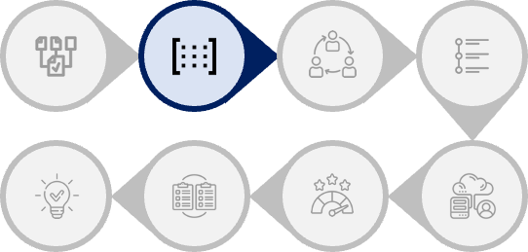
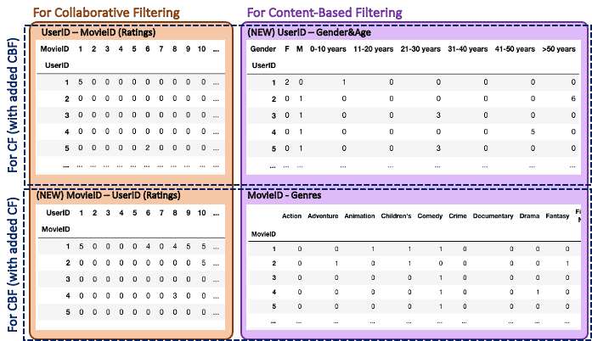
TECHNIQUES
IMPLEMENTATION
EVALUATION
CONCLUSION
Step 2 : Matrix Factorization
Normalize the dataset
(Min-Max scaler)
Single Value Decomposition
(SVD)
To reduce the dimensionality of a dataset and preserve the most important features for the recommendation system
Stevens Institute of Technology

Slide 11
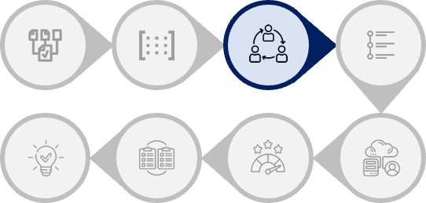
TECHNIQUES
IMPLEMENTATION
EVALUATION
CONCLUSION
Step 3 : Build Collaborative Filtering (with added CBF)
Collaborative Filtering with added Content-Based FIltering
Cosine similarity
Discover the most similar user of a particular user
Recommend top rated movies of the most similar user to a particular user
Stevens Institute of Technology

Slide 12
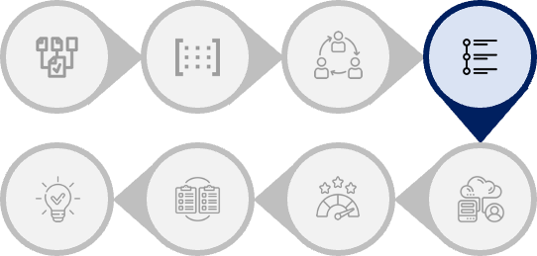
TECHNIQUES
IMPLEMENTATION
EVALUATION
CONCLUSION
Step 4 : Build Content-Based Filtering (with added CF)
Content-Based Filtering with added Collaborative Filtering
Discover the most similar movies of a movie that the most similar user liked
Cosine similarity
Recommend top most similar movies to a particular user
Stevens Institute of Technology

Slide 13
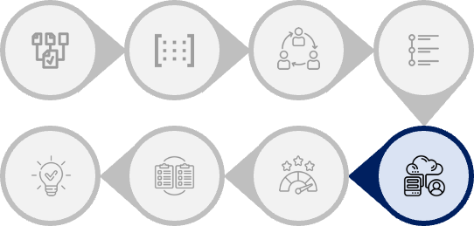

TECHNIQUES
IMPLEMENTATION
EVALUATION
CONCLUSION
Step 5 : Implement Hybrid System
Hybrid Recommendation System
Collaborative Filtering
(with added Content-Based Filtering)
Content-Based Filtering
(with added Collaborative Filtering
Recommend top rated movies of the most similar user to a particular user
Recommend top most similar movies to a particular user
This can solve the problem
Cold Start – Recommend based on user’s preference
Data Sparsity – Use content-based filtering to help recommendations for users that have less ratings data
Limited diversity – Recommend movie in many ways
**For Cold start problem, the system can solve it better if we have the dataset about which types of movies that users like
Stevens Institute of Technology

Slide 14
TECHNIQUES
IMPLEMENTATION
EVALUATION
CONCLUSION
Step 6 & 7 : Evaluation & Performance Comparison (PLAN)
The methods that we will use in evaluation process
Root Mean Squared Error (RMSE)
Mean Absolute Percentage Error (MAPE)
To find the difference between the predicted values and the actual values of a variable
Traditional System
Hybrid Recommendation System
Collaborative Filtering
Collaborative Filtering
(with added Content-Based Filtering)
Compare the result
[UserID – MovieID (Ratings)]
[UserID – MovieID (Ratings)] + [UserID – Gender&Age]
Content-Based Filtering
Content-Based Filtering
(with added Collaborative Filtering
Compare the result
MovieID – UserID (Ratings)
MovieID – UserID (Ratings) + MovieID - Genres
Stevens Institute of Technology

Slide 15

THANK YOU
FOR YOUR ATTENTION
Stevens Institute of Technology

